Slide 1
Dynamic Programming
Dynamic Programming is a general algorithm design technique
for solving problems defined by recurrences with overlapping
subproblems
Invented by American mathematician Richard Bellman in the 1950s to solve optimization problems and later assimilated by CS
“Programming” here means “planning”
Main idea:
    set up a recurrence relating a solution to a larger instance to solutions of some smaller instances
    - solve smaller instances once
    record solutions in a table
    extract solution to the initial instance from that table

Slide 2
Example 1: Fibonacci numbers
Recall definition of Fibonacci numbers:
  F(n) = F(n-1) + F(n-2)
  F(0) = 0
  F(1) = 1
Computing the n^{th} Fibonacci number recursively (top-down):
F(n)
F(n-1) + F(n-2)
F(n-2) + F(n-3) F(n-3) + F(n-4)
...

Slide 3
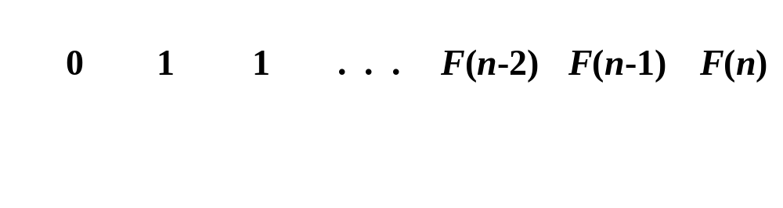
Example 1: Fibonacci numbers (cont.)
  Computing the n^{th} Fibonacci number using bottom-up iteration and recording results:
F(0) = 0
F(1) = 1
F(2) = 1+0 = 1
…
F(n-2) =
F(n-1) =
F(n) = F(n-1) + F(n-2)
Efficiency:
- time
- space

Slide 4
Example 2: Coin-row problem
There is a row of n coins whose values are some positive integers c₁, c₂,...,c_{n}, not necessarily distinct. The goal is to pick up the maximum amount of money subject to the constraint that no two coins adjacent in the initial row can be picked up.
E.g.: 5, 1, 2, 10, 6, 2. What is the best selection?

Slide 5
DP solution to the coin-row problem
Let F(n) be the maximum amount that can be picked up from the row of n coins. To derive a recurrence for F(n), we partition all the allowed coin selections into two groups:
those without last coin – the max amount is ?
those with the last coin -- the max amount is ?
Thus we have the following recurrence
F(n) = max{c_{n} + F(n-2), F(n-1)} for n > 1,
F(0) = 0, F(1)=c₁

Slide 6
DP solution to the coin-row problem (cont.)
F(n) = max{c_{n} + F(n-2), F(n-1)} for n > 1,
F(0) = 0, F(1)=c₁
index | 0 | 1 | 2 | 3 | 4 | 5 | 6
coins | -- | 5 | 1 | 2 | 10 | 6 | 2
F( )
Max amount:
Coins of optimal solution:
Time efficiency:
Space efficiency:
Note: All smaller instances were solved.

Slide 7
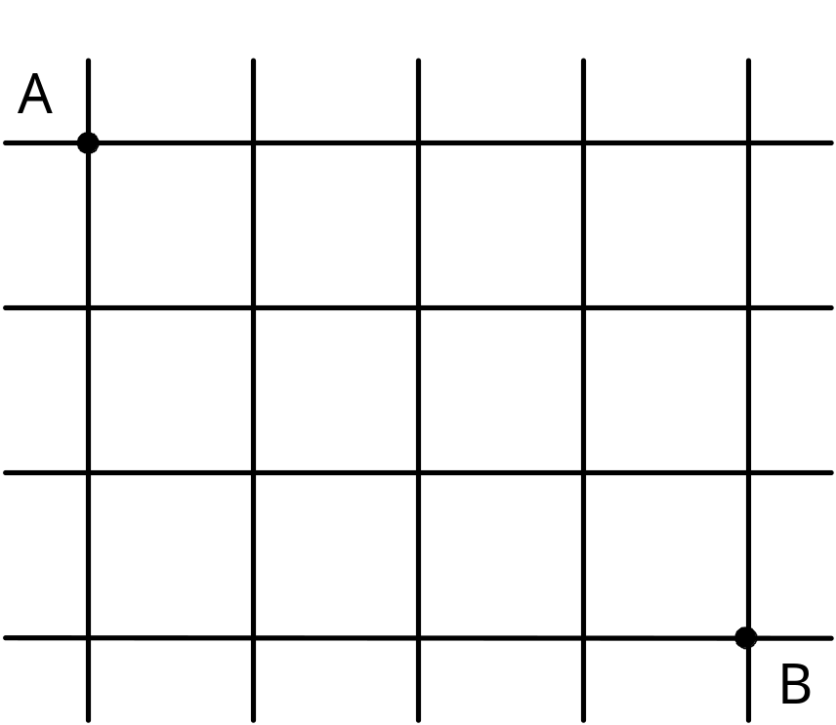
Example 3: Path counting
Consider the problem of counting the number of shortest paths from point A to point B in a city with perfectly horizontal streets and vertical avenues

Slide 8
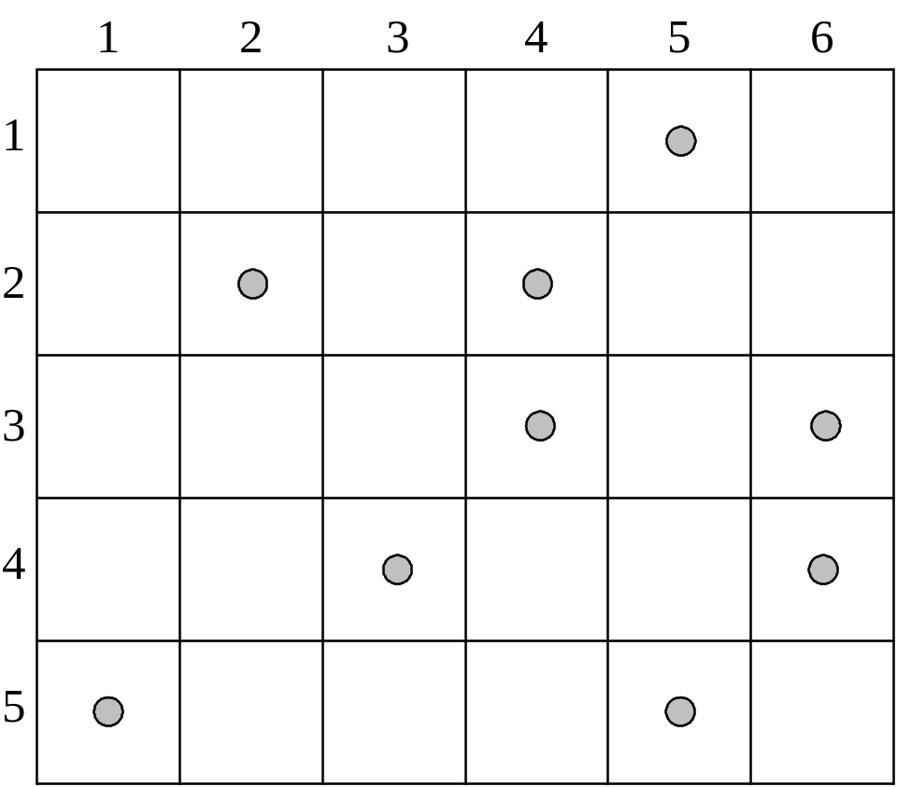
Example 4: Coin-collecting by robot
Several coins are placed in cells of an n×m board. A robot, located in the upper left cell of the board, needs to collect as many of the coins as possible and bring them to the bottom right cell. On each step, the robot can move either one cell to the right or one cell down from its current location.

Slide 9
Solution to the coin-collecting problem
Let F(i,j) be the largest number of coins the robot can collect and bring to cell (i,j) in the ith row and jth column.
The largest number of coins that can be brought to cell (i,j):
from the left neighbor ?
from the neighbor above?
The recurrence:
F(i, j) = max{F(i-1, j), F(i, j-1)} + c_{ij} for 1 ≤ i ≤ n, 1 ≤ j ≤ m
where c_{ij} = 1 if there is a coin in cell (i,j), and c_{ij} = 0 otherwise
F(0, j) = 0 for 1 ≤ j ≤ m and F(i, 0) = 0 for 1 ≤ i ≤ n.

Slide 10
Solution to the coin-collecting problem (cont.)
F(i, j) = max{F(i-1, j), F(i, j-1)} + c_{ij} for 1 ≤ i ≤ n, 1 ≤ j ≤ m
where c_{ij} = 1 if there is a coin in cell (i,j), and c_{ij} = 0 otherwise
F(0, j) = 0 for 1 ≤ j ≤ m and F(i, 0) = 0 for 1 ≤ i ≤ n.

Slide 11
Other examples of DP algorithms
Computing a binomial coefficient (# 9, Exercises 8.1)
General case of the change making problem (Sec. 8.1)
Some difficult discrete optimization problems:
- knapsack (Sec. 8.2)
- traveling salesman
Constructing an optimal binary search tree (Sec. 8.3)
Warshall’s algorithm for transitive closure (Sec. 8.4)
Floyd’s algorithm for all-pairs shortest paths (Sec. 8.4)

Slide 12
Knapsack Problem by DP
Given n items of
  integer weights: w₁ w₂ … w_{n}
  values: v₁ v₂ … v_{n}
a knapsack of integer capacity W
find most valuable subset of the items that fit into the knapsack
Consider instance defined by first i items and capacity j (j ≤ W).
Let V[i,j] be optimal value of such instance. Then
max {V[i-1,j], v_{i} + V[i-1,j- w_{i}]} if j- w_{i} ≥ 0
V[i,j] =
V[i-1,j] if j- w_{i} < 0
Initial conditions: V[0,j] = 0 and V[i,0] = 0

Slide 13
Knapsack Problem by DP (example)
Example: Knapsack of capacity W = 5
item weight value
1 2 $12
2 1 $10
3 3 $20
4 2 $15 capacity j
0 1 2 3 4 5
0
w₁ = 2, v₁= 12 1
w₂ = 1, v₂= 10 2
w₃ = 3, v₃= 20 3
w₄ = 2, v₄= 15 4 ?

Slide 14
Optimal Binary Search Trees
Problem: Given n keys a₁ < …< a_{n} and probabilities p₁ ≤ … ≤ p_{n}
searching for them, find a BST with a minimum
average number of comparisons in successful search.
Since total number of BSTs with n nodes is given by C(2n,n)/(n+1), which grows exponentially, brute force is hopeless.
Example: What is an optimal BST for keys A, B, C, and D with
search probabilities 0.1, 0.2, 0.4, and 0.3, respectively?

Slide 15
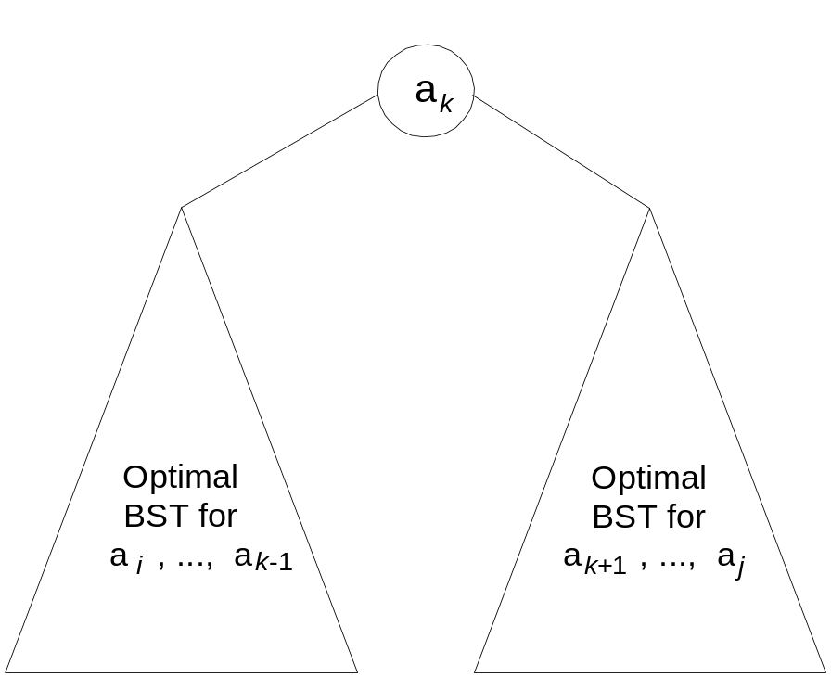
DP for Optimal BST Problem
Let C[i,j] be minimum average number of comparisons made in T[i,j], optimal BST for keys a_{i} < …< a_{j} , where 1 ≤ i ≤ j ≤ n. Consider optimal BST among all BSTs with some a_{k} (i ≤ k ≤ j ) as their root; T[i,j] is the best among them.
C[i,j] =
min {p_{k} · 1 +
∑ p_{s} (level a_{s} in T[i,k-1] +1) +
∑ p_{s} (level a_{s} in T[k+1,j] +1)}
i ≤ k ≤ j
k-1
s = i
j
s =k+1

Slide 16
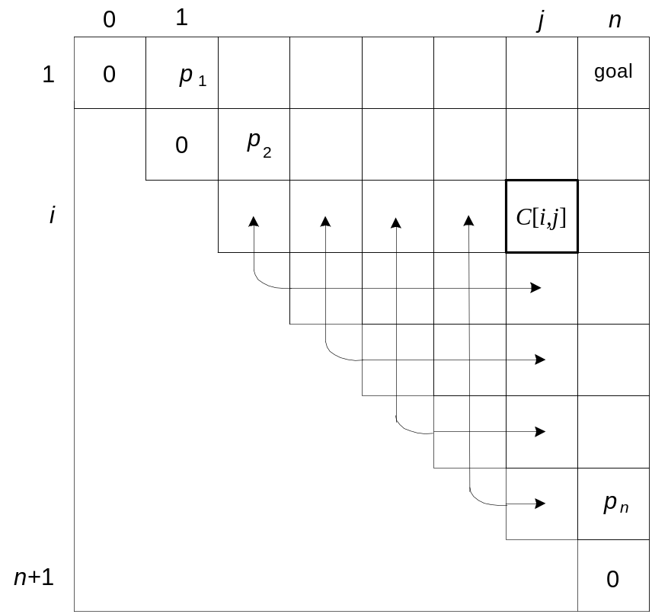
DP for Optimal BST Problem (cont.)
After simplifications, we obtain the recurrence for C[i,j]:
C[i,j] = min {C[i,k-1] + C[k+1,j]} + ∑ p_{s} for 1 ≤ i ≤ j ≤ n
C[i,i] = p_{i} for 1 ≤ i ≤ j ≤ n
j
i ≤ k ≤ j
s = i

Slide 17
Example: key A B C D
probability 0.1 0.2 0.4 0.3
The tables below are filled diagonal by diagonal: the left one is filled using the recurrence
C[i,j] = min {C[i,k-1] + C[k+1,j]} + ∑ p_{s ,} C[i,i] = p_{i} ;
the right one, for trees’ roots, records k’s values giving the minima
j
i ≤ k ≤ j
s = i
_{i} ^{j}
 | 0 | 1 | 2 | 3 | 4
1 | 0 | .1 | .4 | 1.1 | 1.7
2 |  | 0 | .2 | .8 | 1.4
3 |  |  | 0 | .4 | 1.0
4 |  |  |  | 0 | .3
5 |  |  |  |  | 0
_{i} ^{j}
 | 0 | 1 | 2 | 3 | 4
1 |  | 1 | 2 | 3 | 3
2 |  |  | 2 | 3 | 3
3 |  |  |  | 3 | 3
4 |  |  |  |  | 4
5
C
B
D
A
optimal BST

Slide 18
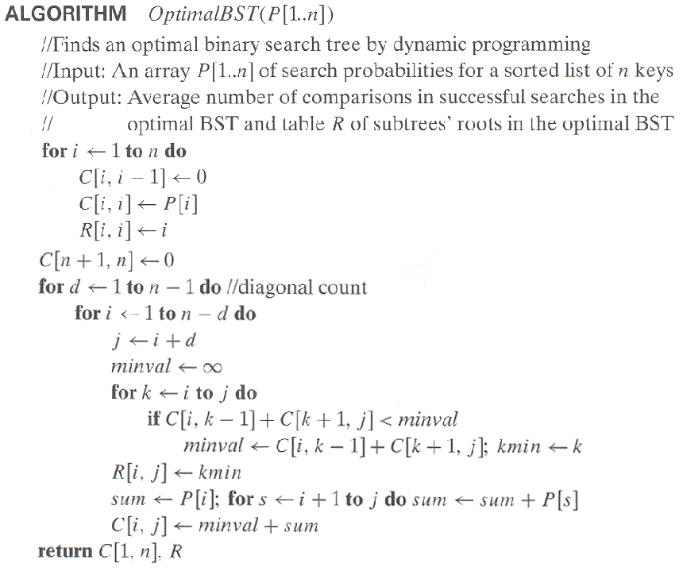
Optimal Binary Search Trees

Slide 19
Analysis DP for Optimal BST Problem
Time efficiency: Θ(n³) but can be reduced to Θ(n²) by taking
advantage of monotonicity of entries in the
root table, i.e., R[i,j] is always in the range
between R[i,j-1] and R[i+1,j]
Space efficiency: Θ(n²)
Method can be expended to include unsuccessful searches

Slide 20
Warshall’s Algorithm: Transitive Closure
Computes the transitive closure of a relation
Alternatively: existence of all nontrivial paths in a digraph
Example of transitive closure:
3
3
1
1
4
4
0 0 1 0
1 1 1 1
0 0 0 0
1 1 1 1
2
0 0 1 0
1 0 0 1
0 0 0 0
0 1 0 0
2

Slide 21
Warshall’s Algorithm
Constructs transitive closure T as the last matrix in the sequence of n-by-n matrices R⁽⁰⁾, … , R^{(k)}, … , R^{(n)} where
R^{(k)}[i,j] = 1 iff there is nontrivial path from i to j with only first k vertices allowed as intermediate
Note that R⁽⁰⁾ = A (adjacency matrix), R^{(n)} = T (transitive closure)
3
3
3
3
3
1
1
1
1
1
4
4
4
2
4
4
2
2
2
2
R⁽⁰⁾
0 0 1 0
1 0 0 1
0 0 0 0
0 1 0 0
R⁽¹⁾
0 0 1 0
1 0 1 1
0 0 0 0
0 1 0 0
R⁽²⁾
0 0 1 0
1 0 1 1
0 0 0 0
1 1 1 1
R⁽³⁾
0 0 1 0
1 0 1 1
0 0 0 0
1 1 1 1
R⁽⁴⁾
0 0 1 0
1 1 1 1
0 0 0 0
1 1 1 1

Slide 22
Warshall’s Algorithm (recurrence)
On the k-th iteration, the algorithm determines for every pair of vertices i, j if a path exists from i and j with just vertices 1,…,k allowed as intermediate
        R^{(k-1)}[i,j] (path using just 1 ,…,k-1)
R^{(k)}[i,j] = or
      R^{(k-1)}[i,k] and R^{(k-1)}[k,j] (path from i to k
      and from k to i
      using just 1 ,…,k-1)
{
k
i
j

Slide 23
Warshall’s Algorithm (matrix generation)
Recurrence relating elements R^{(k)} to elements of R^{(k-1)} is:
      R^{(k)}[i,j] = R^{(k-1)}[i,j] or (R^{(k-1)}[i,k] and R^{(k-1)}[k,j])
It implies the following rules for generating R^{(k)} from R^{(k-1)}:
Rule 1 If an element in row i and column j is 1 in R^{(k-1)},
it remains 1 in R^{(k)}
Rule 2 If an element in row i and column j is 0 in R^{(k-1)},
it has to be changed to 1 in R^{(k)} if and only if
the element in its row i and column k and the element
in its column j and row k are both 1’s in R^{(k-1)}

Slide 24
Warshall’s Algorithm (example)
3
0 0 1 0
1 0 0 1
0 0 0 0
0 1 0 0
0 0 1 0
1 0 1 1
0 0 0 0
0 1 0 0
1
R⁽⁰⁾ ⁼
R⁽¹⁾ ⁼
2
4
0 0 1 0
1 0 1 1
0 0 0 0
1 1 1 1
0 0 1 0
1 0 1 1
0 0 0 0
1 1 1 1
0 0 1 0
1 1 1 1
0 0 0 0
1 1 1 1
R⁽²⁾ ⁼
R⁽³⁾ ⁼
R⁽⁴⁾ ⁼

Slide 25
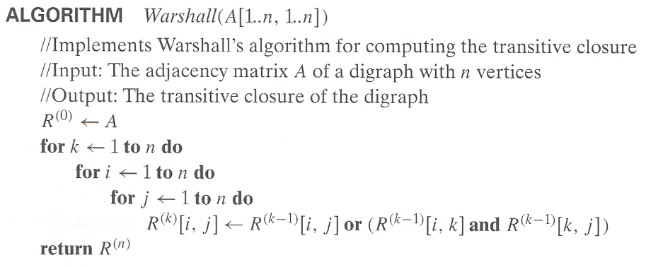
Warshall’s Algorithm (pseudocode and analysis)
Time efficiency: Θ(n³)
Space efficiency: Matrices can be written over their predecessors

Slide 26
Floyd’s Algorithm: All pairs shortest paths
Problem: In a weighted (di)graph, find shortest paths between
every pair of vertices
Same idea: construct solution through series of matrices D⁽⁰⁾, …,
D ^{(n)} using increasing subsets of the vertices allowed
as intermediate
Example:
4
3
1
1
6
1
5
4
2
3

Slide 27
Floyd’s Algorithm (matrix generation)
On the k-th iteration, the algorithm determines shortest paths between every pair of vertices i, j that use only vertices among 1,…,k as intermediate
D^{(k)}[i,j] = min {D^{(k-1)}[i,j], D^{(k-1)}[i,k] + D^{(k-1)}[k,j]}
D^{(k-1)}[i,k]
k
i
D^{(k-1)}[k,j]
D^{(k-1)}[i,j]
j

Slide 28
Floyd’s Algorithm (example)
2
1
2
0 ∞ 3 ∞ 2 0 ∞ ∞
∞ 7 0 1
6 ∞ ∞ 0
0 ∞ 3 ∞
2 0 5 ∞
∞ 7 0 1
6 ∞ 9 0
3
6
7
D⁽⁰⁾ ⁼
D⁽¹⁾ ⁼
3
1
4
0 ∞ 3 ∞
2 0 5 ∞
9 7 0 1
6 ∞ 9 0
0 10 3 4
2 0 5 6
9 7 0 1
6 16 9 0
0 10 3 4
2 0 5 6
7 7 0 1
6 16 9 0
D⁽²⁾ ⁼
D⁽³⁾ ⁼
D⁽⁴⁾ ⁼

Slide 29
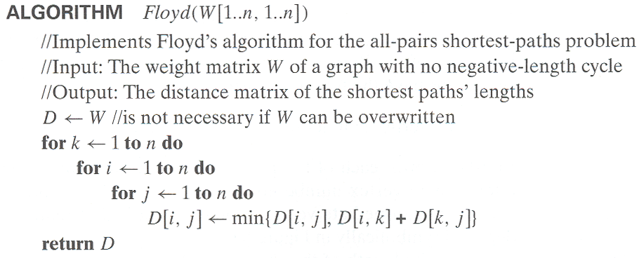
Floyd’s Algorithm (pseudocode and analysis)
Time efficiency: Θ(n³)
Space efficiency: Matrices can be written over their predecessors
Note: Shortest paths themselves can be found, too (Problem 10)

